Slide 1
Surgeon’s Perspective
3-D image data for education and development of future surgical technologies
Project founded by VINNOVA

Slide 2

UN’s Sustainable Development Goals
Surgeon’s Perspective: Today's surgical reports consists of a written textual presentation which is hard to understand for others than the surgeon and the corresponding core-team. One goal is to improve tomorrow's surgical reports by replacing it with videos containing 3D-images in high resolution. In this way, the report will be more complete and understandable for a larger audience and it can serve as a learning platform useful for e.g. students in medicine, and practicing surgeons preparing for a similar operation. In the future it can also serve as a platform for development of new (autonomous) surgical methods. The multi-disciplinary project involves researchers and practitioners from Engineering, Law and Medicine. The project utilizes recent technology advancements e.g. image capturing, file compression, and robotics, in order to track the precise perspective of the surgeon throughout the operation. Our vision is to provide hospitals with modern surgical reports, facilitating for improved learning in surgical operations and healthcare.
Ensure healthy lives and promote well-being for all at all ages

Slide 3
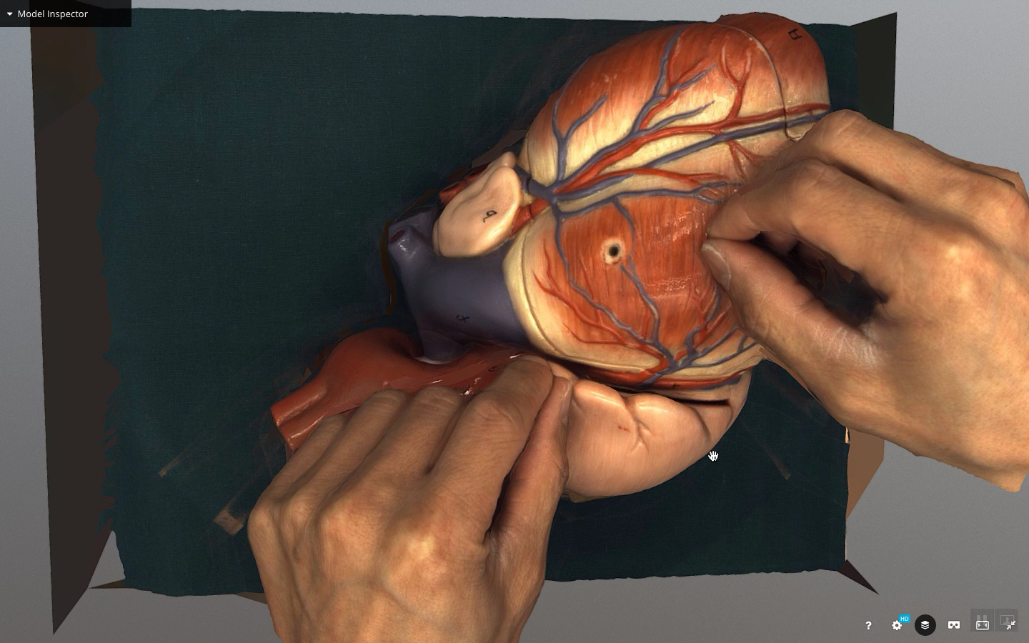
Example of 3D video with plastic heart

Slide 4
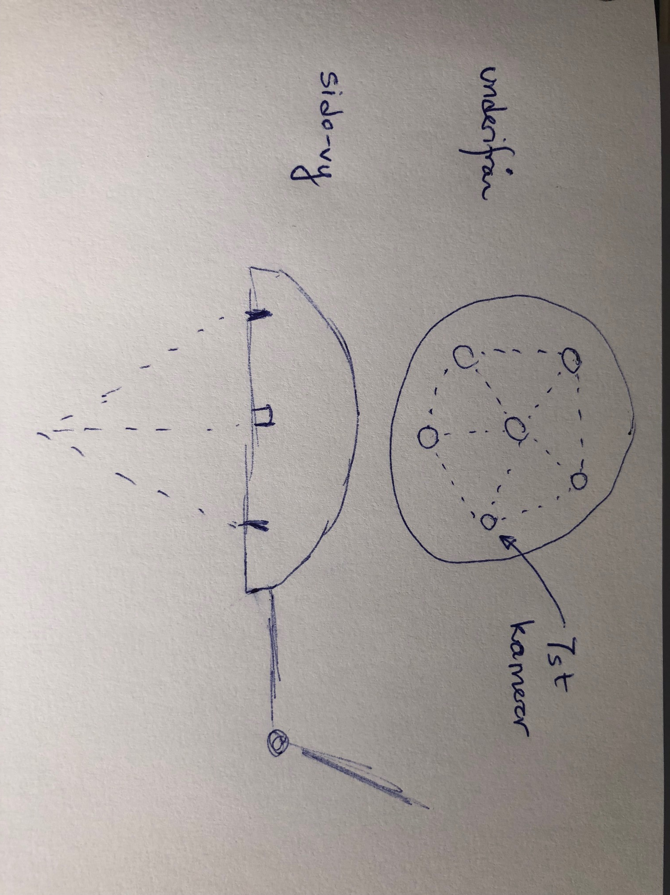
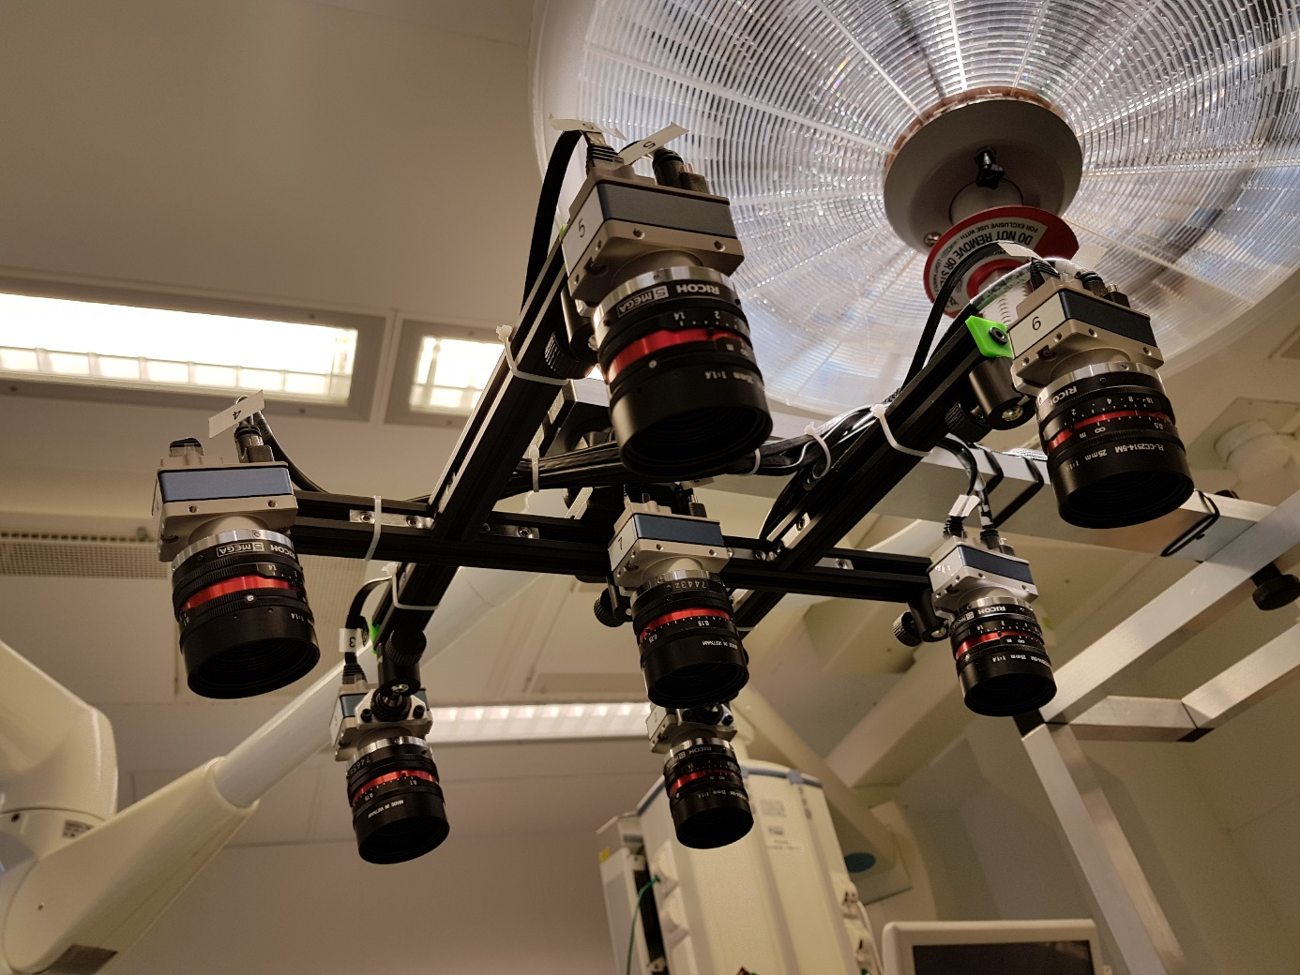
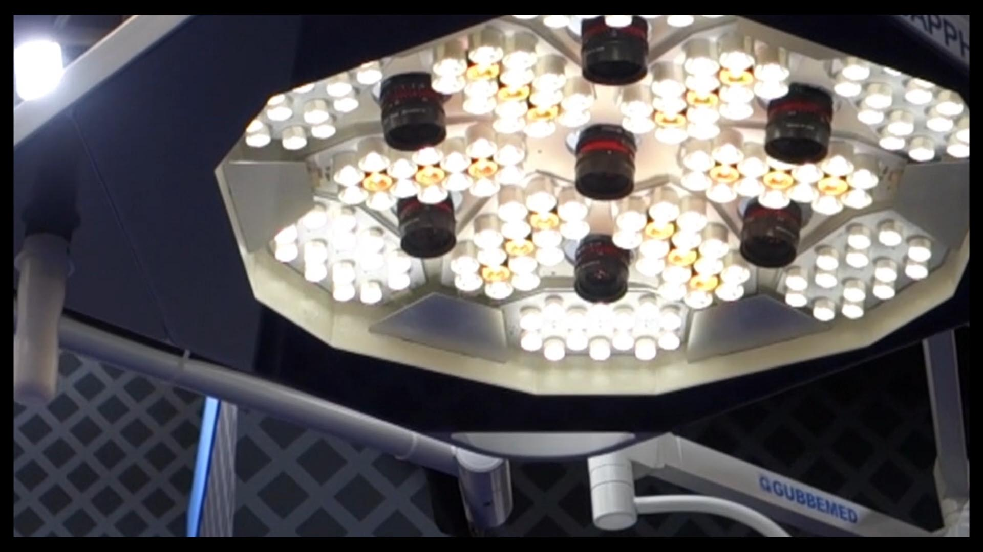
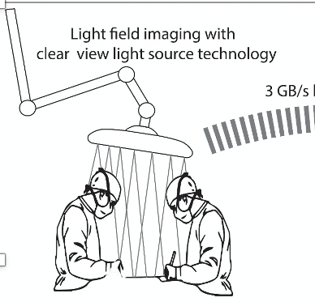
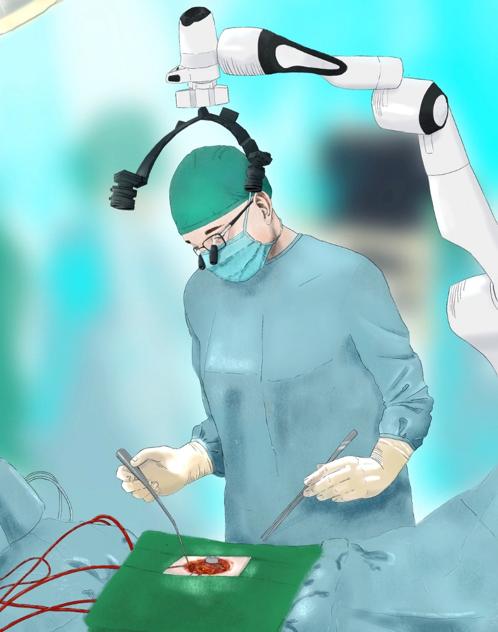
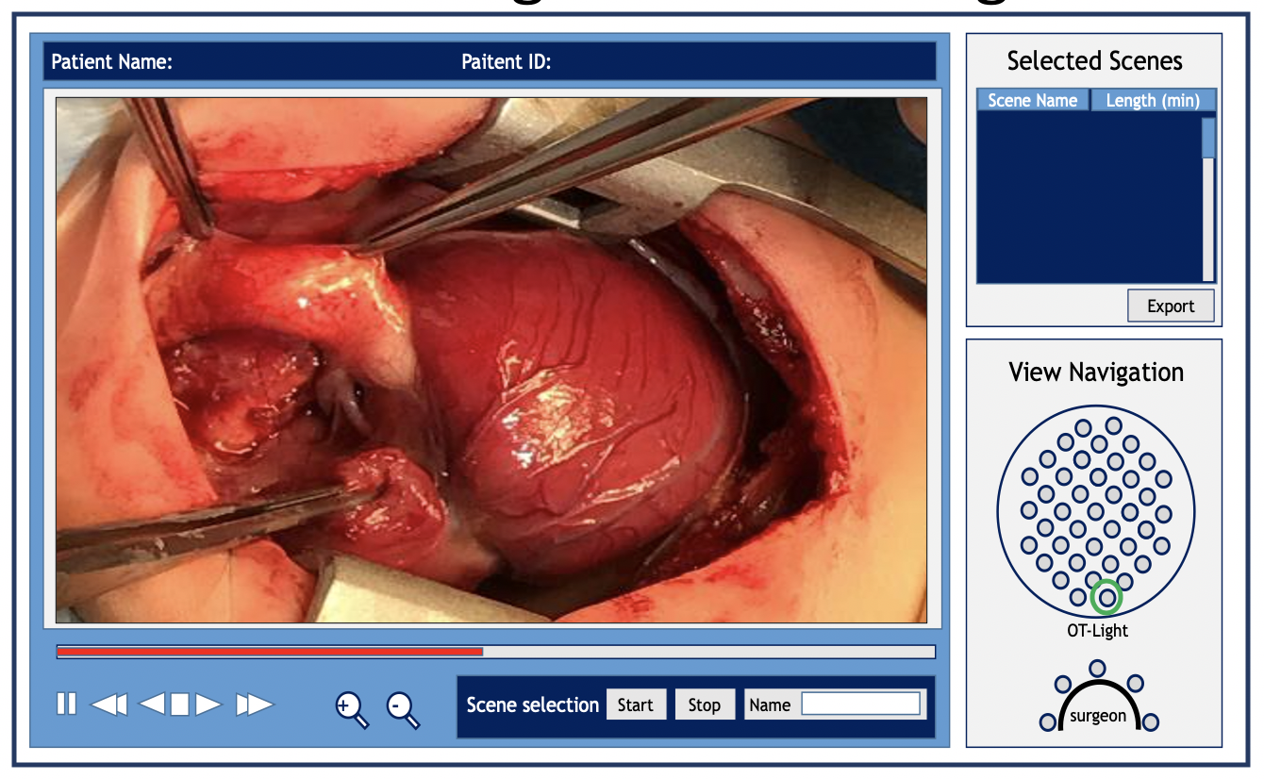
Examples of tools developed in the project
Development of a light-source with integrated cameras
Exploring various ways to record and display the ”surgeon’s perspective” (i.e. everything that happens during the surgery)

Slide 5
7 partners ready to implement the solutions
Robert Risberg (CEO, Screen9 AB)
René Hoffmann (CEO, Gubbemed Int. GmbH)
Dipa Velagapudy (Head of GTS Multi Cloud Services, IBM Nordic)
Lena Sundquist (CEO Kivra Sweden AB)
Charlotta Johnsson (Prof., Dept of Automatic Control, Lund University)
Ulf Maunsbach (Professor, Dept of Law, Lund University)
Carl-Henrik Nilsson (Board Member, Helhjärtad Finans AB)
Phan-Kiet Tran (Sr. Consultant Surgeon, Skåne University Hospital)

