Slide 1
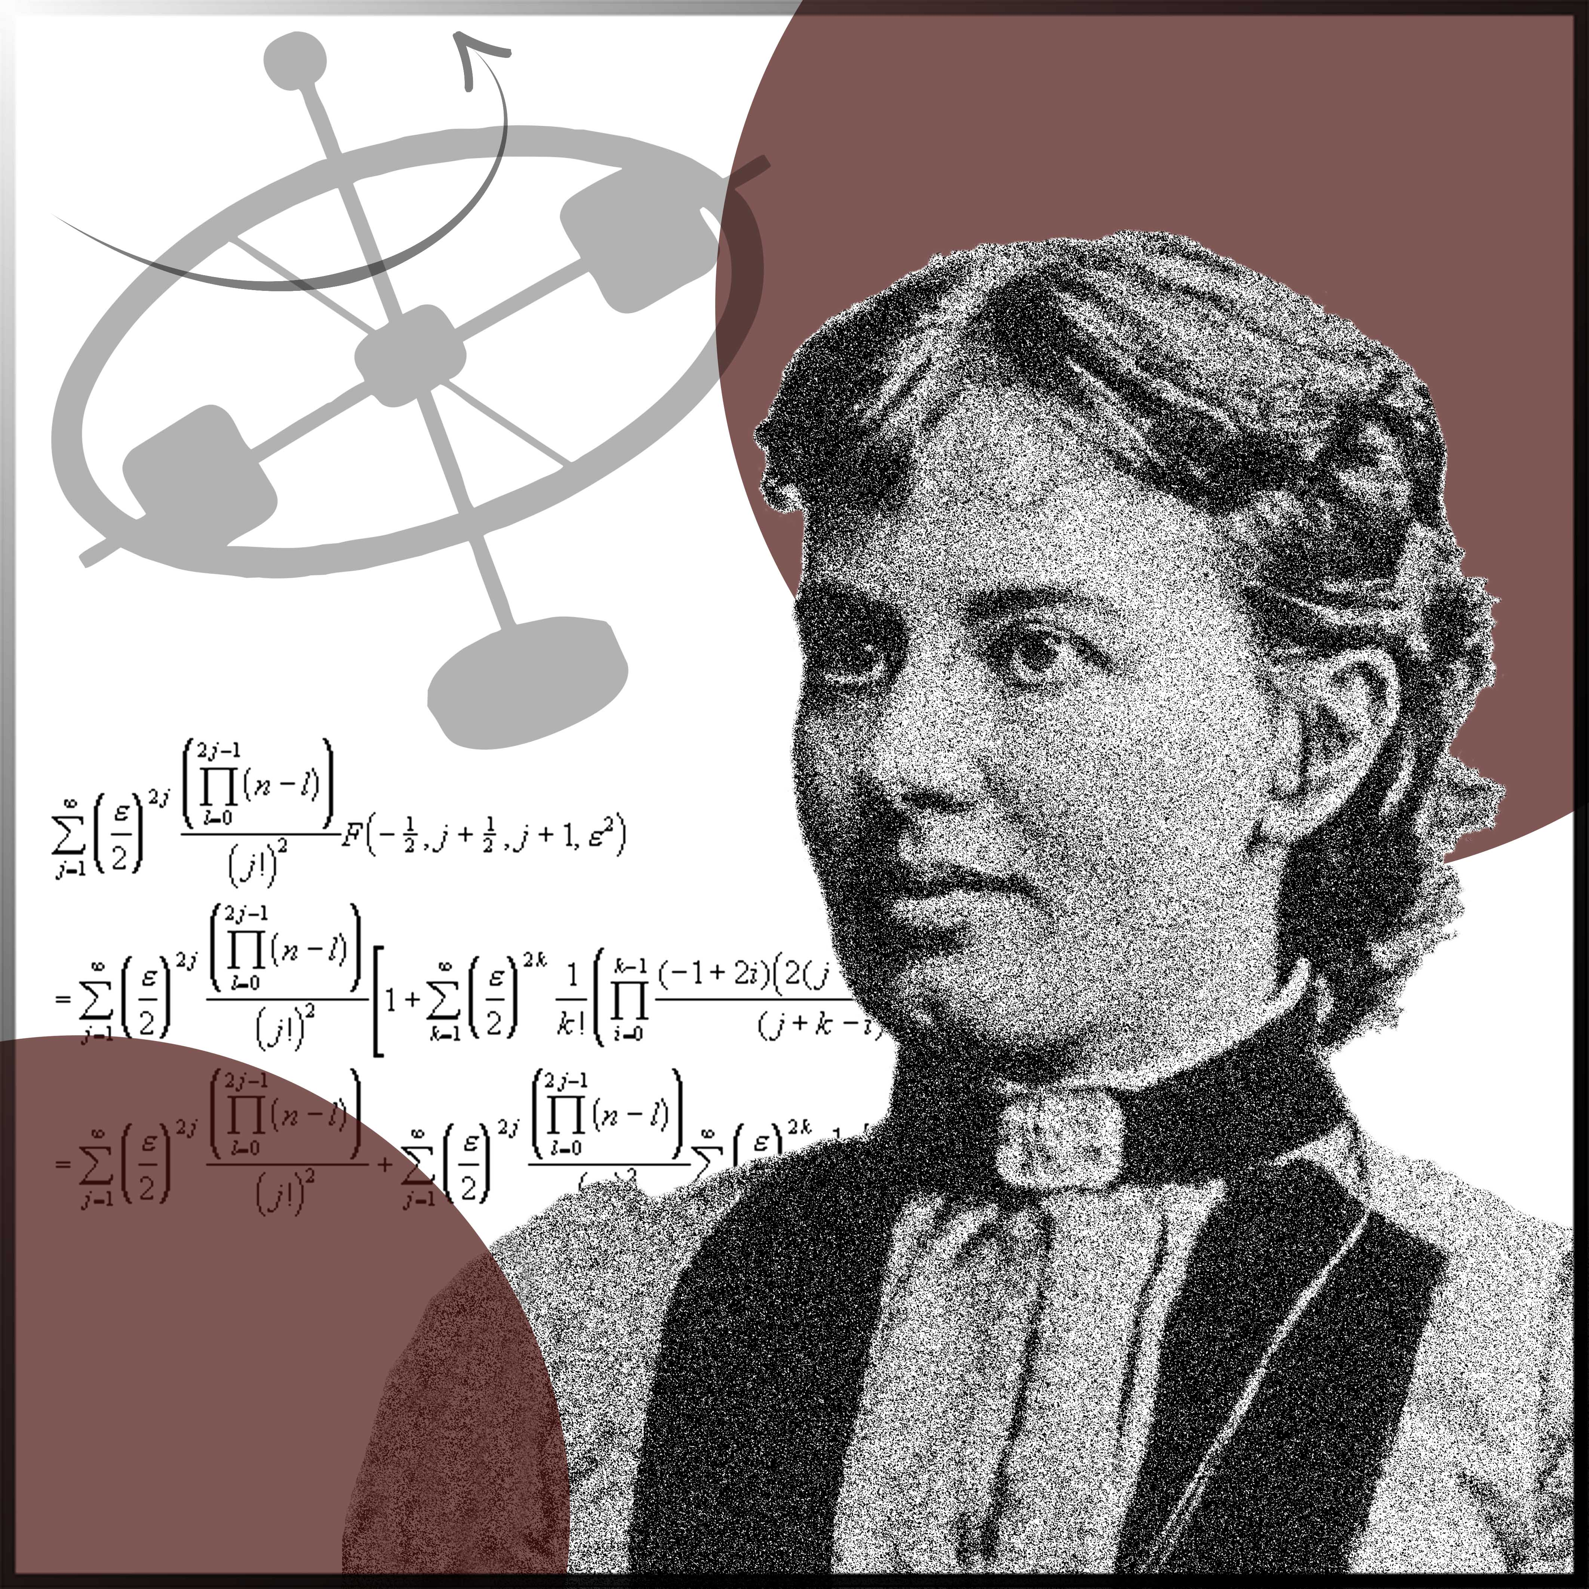

Sofya
Kovalevskaya
(1850-1891)
I began to feel an attraction for my mathematics so intense that I started to neglect my other studies.

Slide 2

Russian mathematician and one of the first women to become a professor of mathematics
Best known for:
The Cauchy-Kovalevskaya theorem, a cornerstone in the theory of partial differential equations, and the Kovalevskaya top, a classic example of a rigid body dynamics problem that is exactly solvable.
A real pioneer of women in science:
Sofya Kovalevskaya was the first woman to receive a PhD in mathematics, the first woman to be appointed a full professorship in Northern Europe, and the first woman to become editor of a scientific journal.

Slide 3

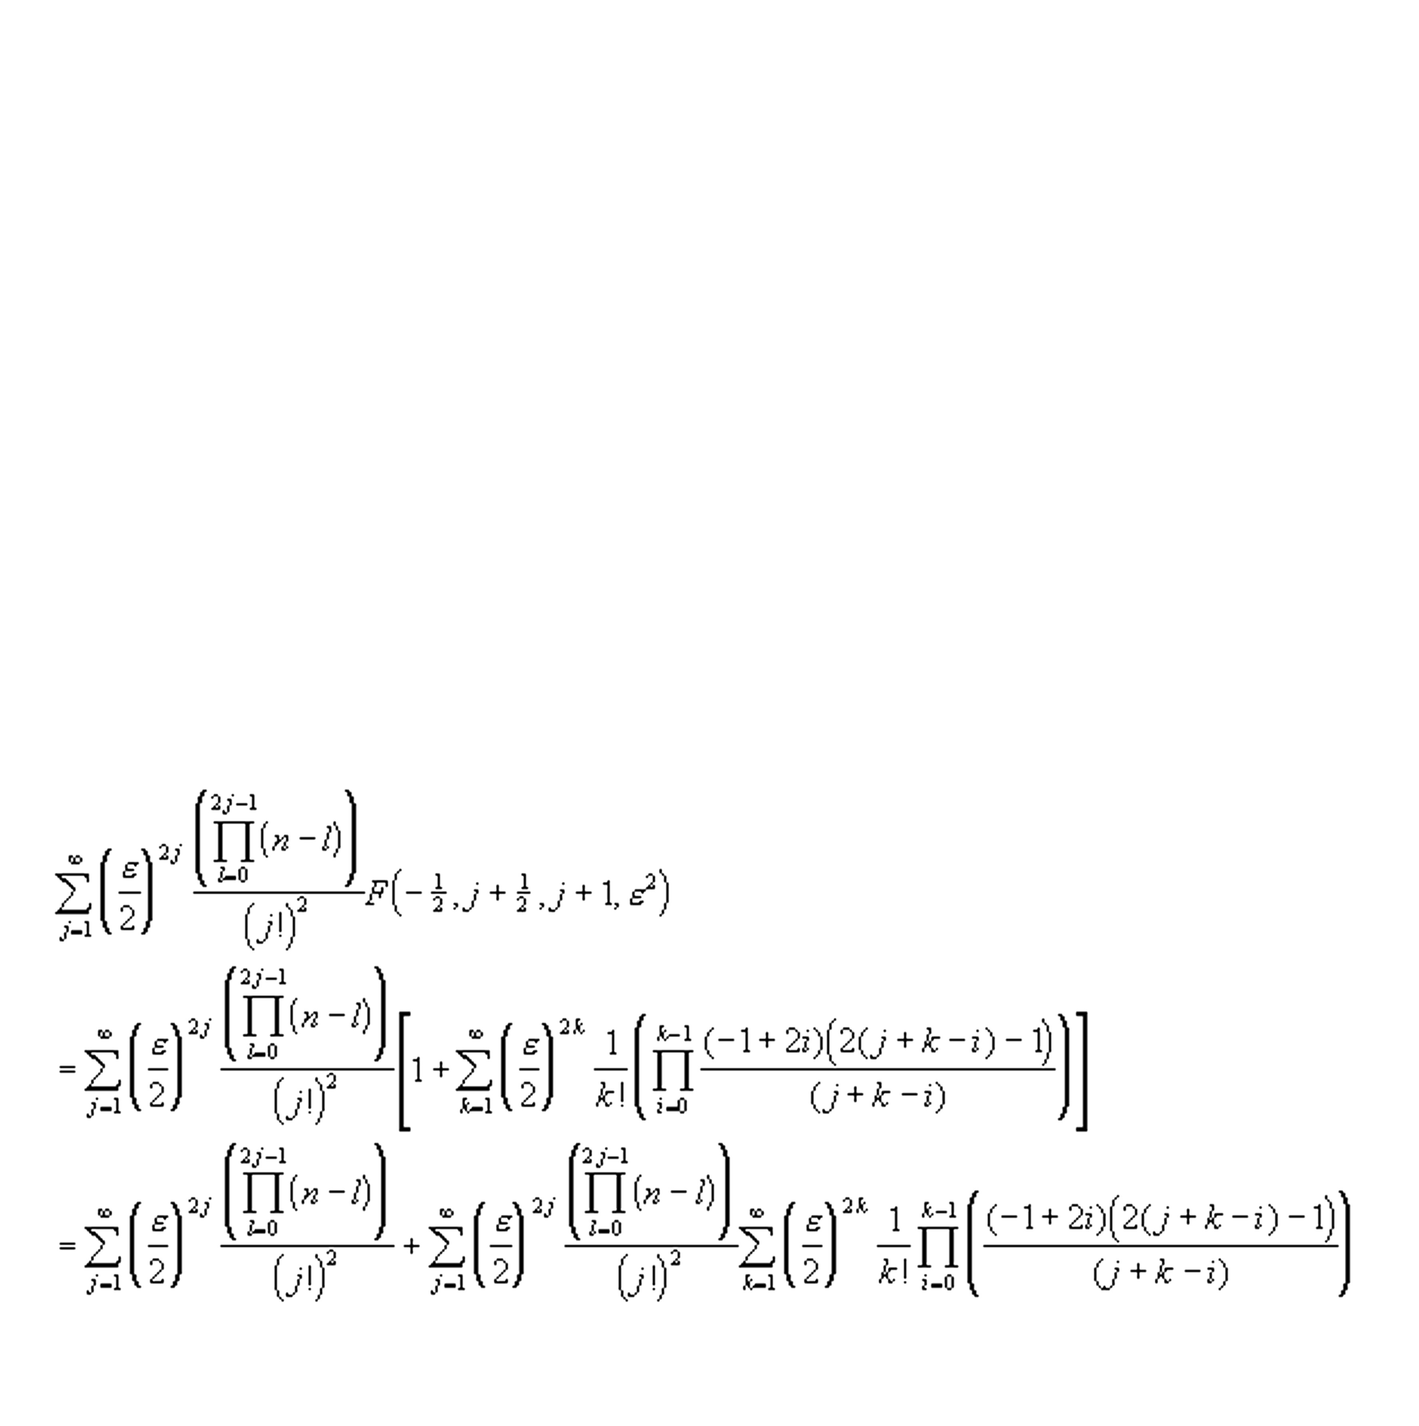
Education:
She was mainly tutored privately since women were not allowed to attend universities at that time. However, for a period of time she in officially attended Heidelberg University to study mathematics.
Influences:
Among others, Karl Weierstrass who was her tutor and promoted her so she could finally receive her doctorate in mathematics.
Honors and awards:
Prix Bordin of the French Academy of Sciences.

Slide 4
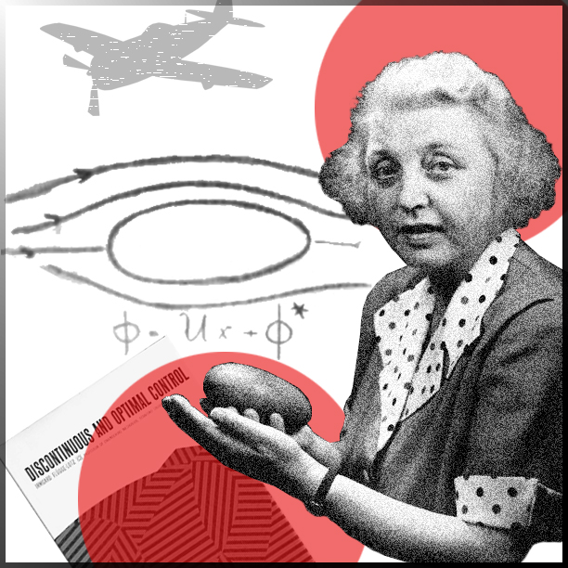

Irmgard
Flügge-Lotz
(1903-1974)
I wanted a life which would never be boring. That meant a life in which always new things would occur. I wanted a career in which I would always be happy, even if
I were to remain unmarried.

Slide 5

German mathematician and pioneer in aviation theory
Best known for:
The theory of discontinuous, or on-off, control systems and the Lotz method, a method for calculating the spanwise lift distribution of a three-dimensional wing.
Appointments:
In 1960, she became the first female professor of engineering at Stanford University after more than a decade of performing the duties of one.
Honors and awards:
The Achievement Award by the Society of Women Engineers (1970) and an honorary doctorate of science by the University of Maryland (1973). She was also chosen by the American Institute of Aeronautics and Astronautics to give the prestigious annual Karman lecture in 1971.

Slide 6

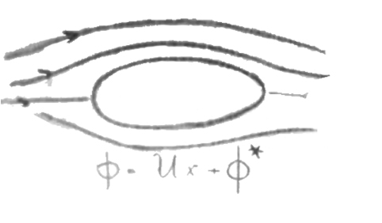

          Education:
Mathematics and engineering at Leibniz University, Hannover.
          Influences:
Irmgard Flügge-Lotz was encouraged by her mother to pursue technical subjects. For many generations, her mother’s family had been involved in construction, and Irmgard Flügge-Lotz often visited construction sites with her uncle and attended matinee shows for technical films.

Slide 7
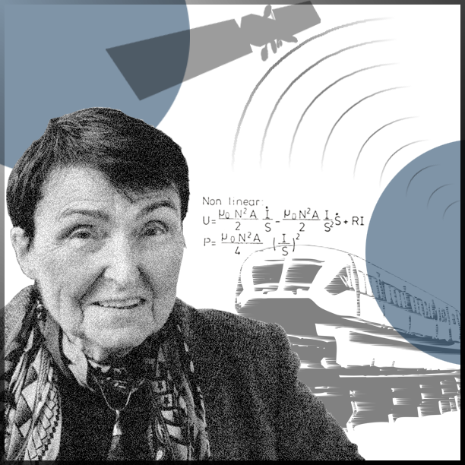

Eveline
Gottzein
(1931-2023)
I was fascinated by the opportunities and determined to use them to the greatest possible extent.

Slide 8

German engineer and expert in control systems for satellites and high-speed trains
Best known for:
The development of control systems for the guidance of high-speed magnetic levitation trains and for developing the Attitude and Orbit Control System (AOCS) of satellites.
Appointments:
Eveline Gottzein was with Bölkow Entwicklungen KG (later MBB) for almost 50 years. She was also an honorary professor of aerospace engineering at the University of Stuttgart, where she taught a course on control problems in space travel. In addition, she has acted as an advisor for the Airbus group.

Slide 9


Honors and awards:
Eveline Gottzein is the first, and so far only, woman to have received the Werner von Siemens ring - one of the highest awards for technical sciences in Germany.
Education:
Electrical engineering, mathematics, and physics at the Technical University of Dresden and the Technical University of Darmstadt.
Influences:
Ludwig Bölkow, the director of Bölkow Entwicklungen KG, and the way he allowed his employees free reign, releasing their creative forces.

Slide 10
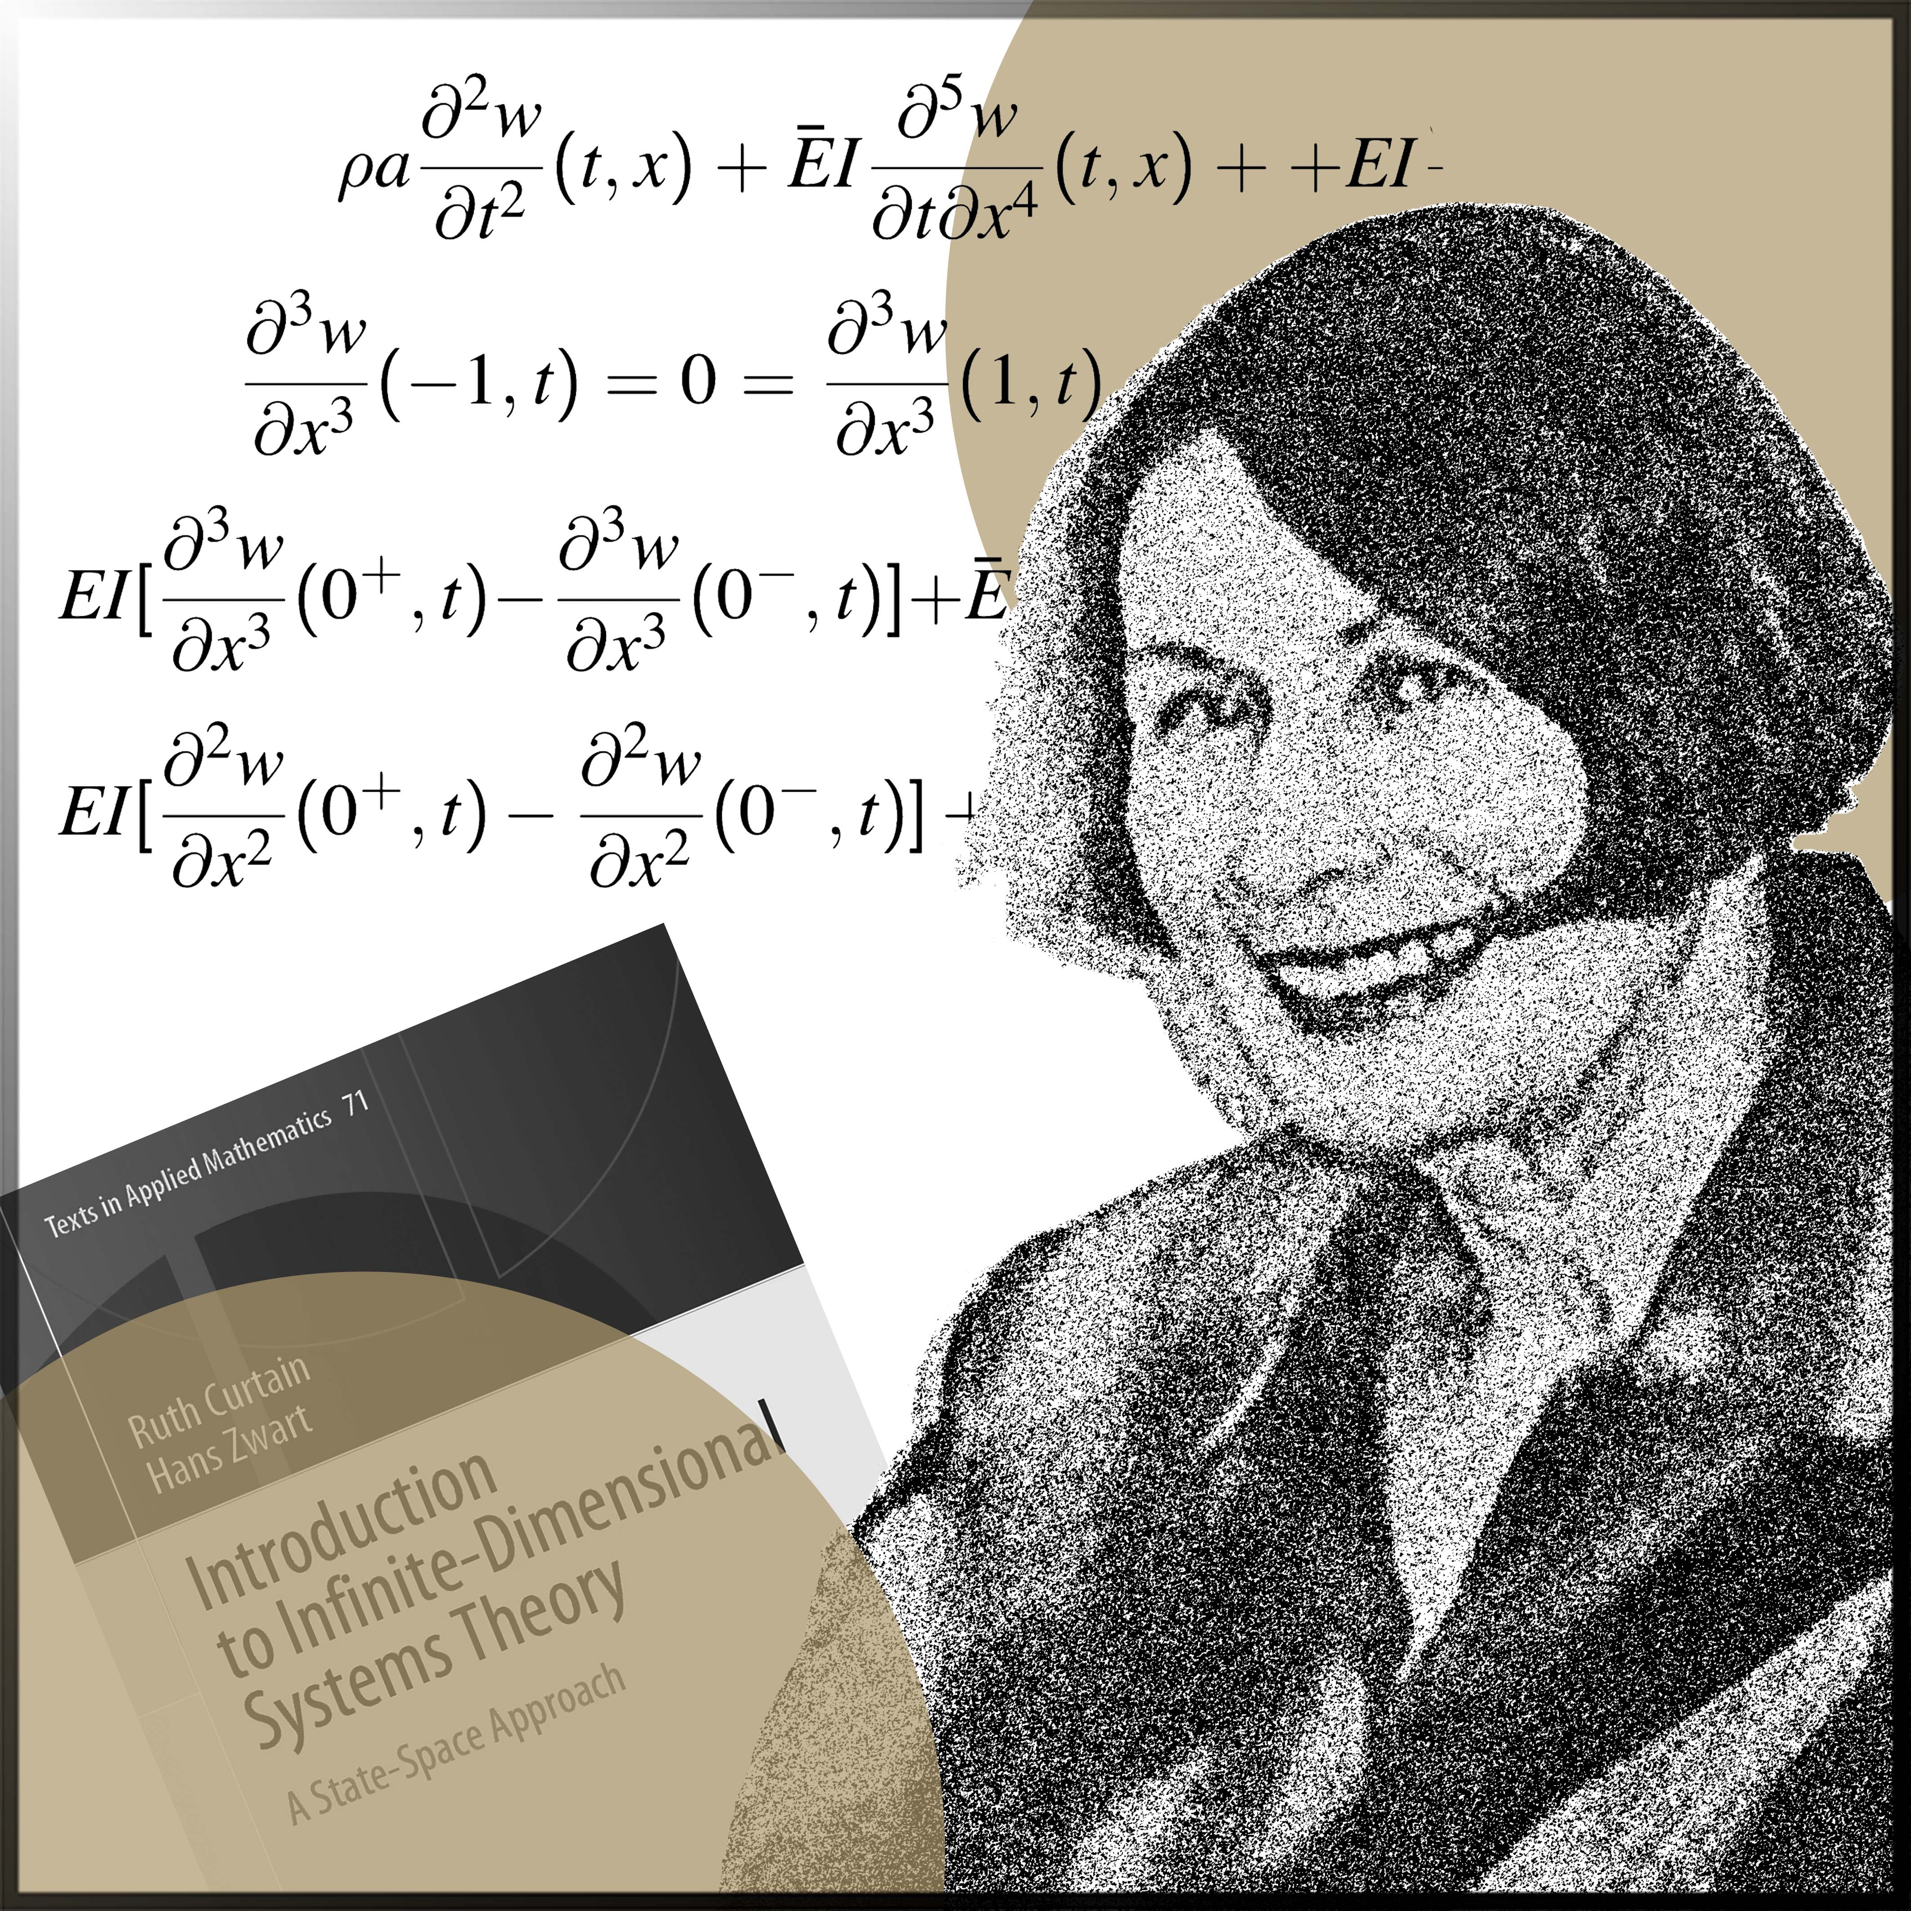

Ruth Curtain
(1941-2018)
When the positions are attractive and allow a wide spectrum of scientific endeavour, women most certainly do apply.
(Ruth Curtain, Margo Brouns, and Jeanine Olsen)

Slide 11
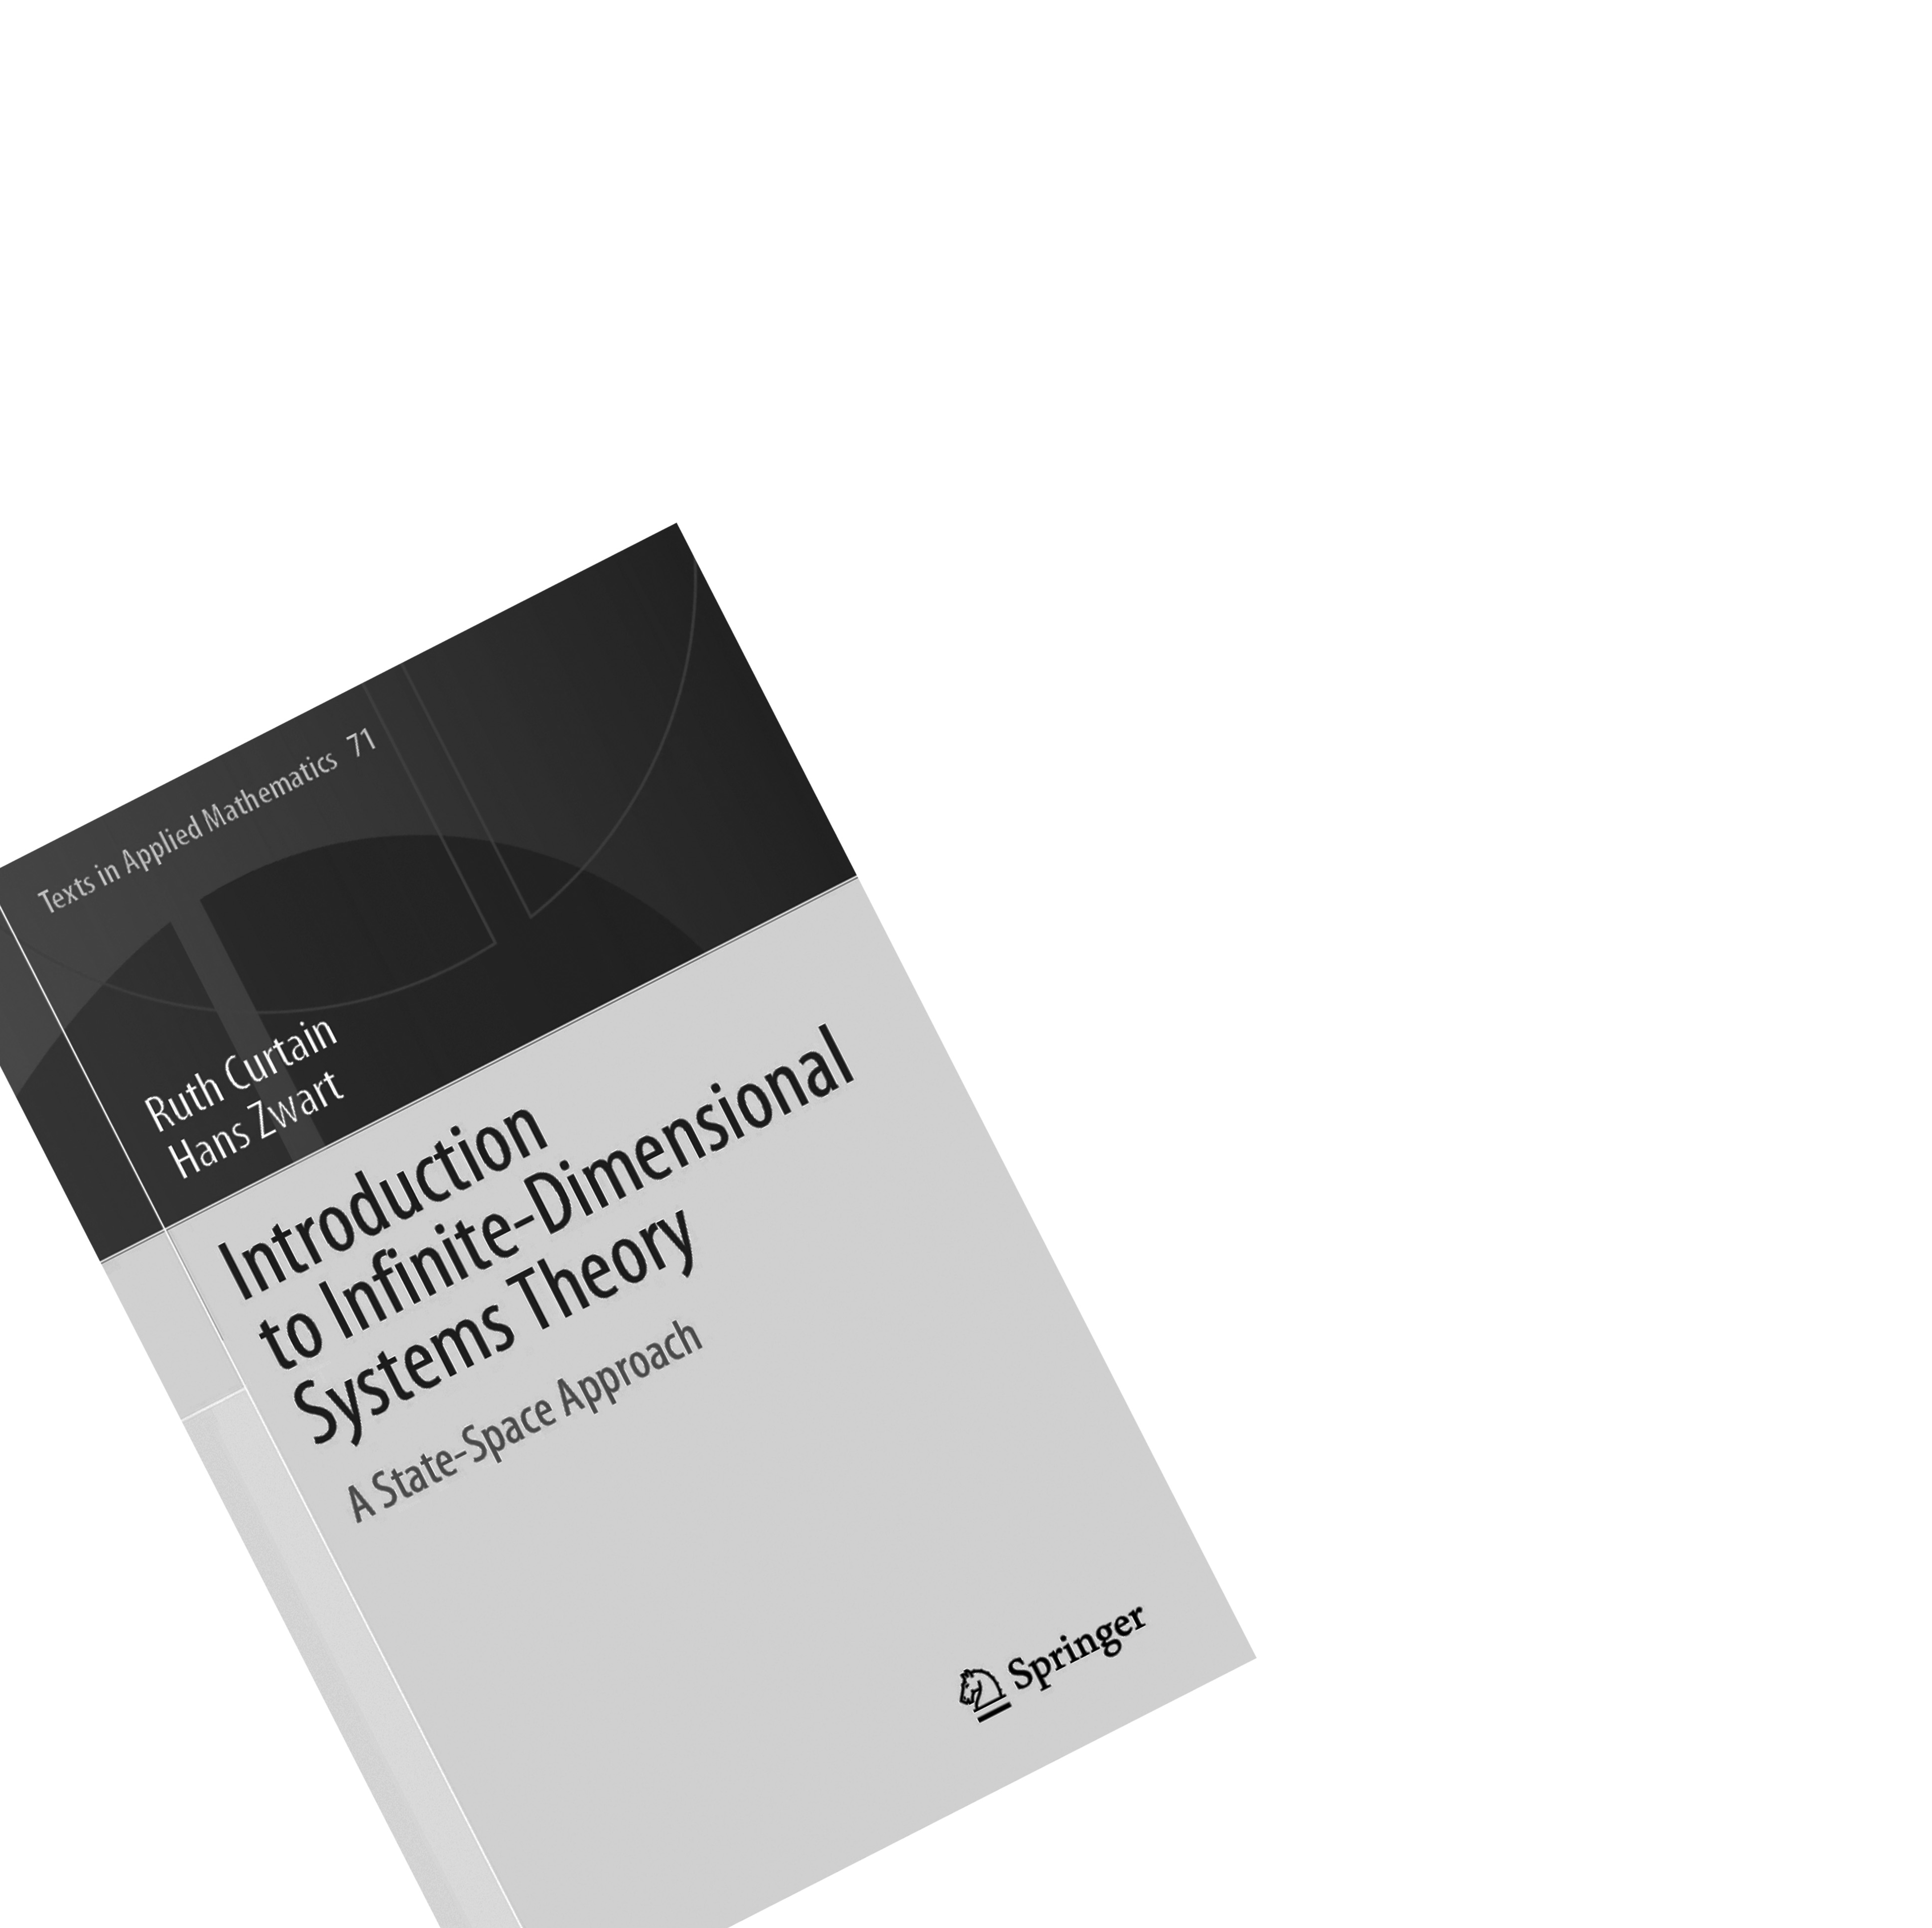
Australian mathematician and pioneer in control of infinite-dimensional systems
Best known for:
Advancing control theory by extending the theory developed for finite-dimensional systems to infinite-dimensional systems. Her book “Introduction to Infinite-Dimensional Systems Theory” is a standard reference within the field.
Appointments:
Professor at the University of Groningen and Fellow of the Institute of Electrical and Electronics Engineers (IEEE).

Slide 12

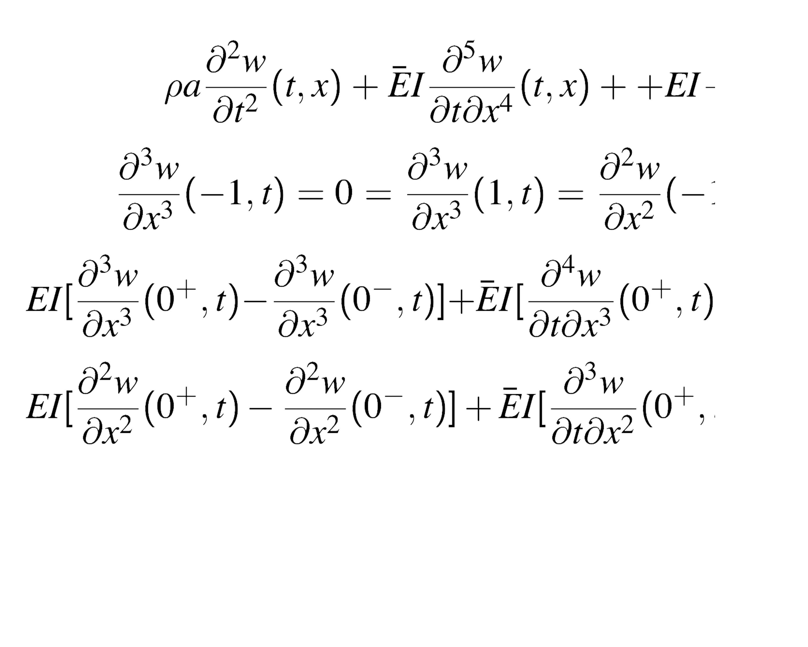
Honors and awards:
The W.T. and Idalia Reid Prize from the Society for Industrial and Applied Mathematics (SIAM) for her fundamental contributions to the theory of infinite dimensional systems and their control.
Education:
Mathematics at the University of Melbourne..
Influences:
Her mother, who Ruth Curtain said was
“a great fighter”, referring to her struggle
for her daughters’ education.

Slide 13
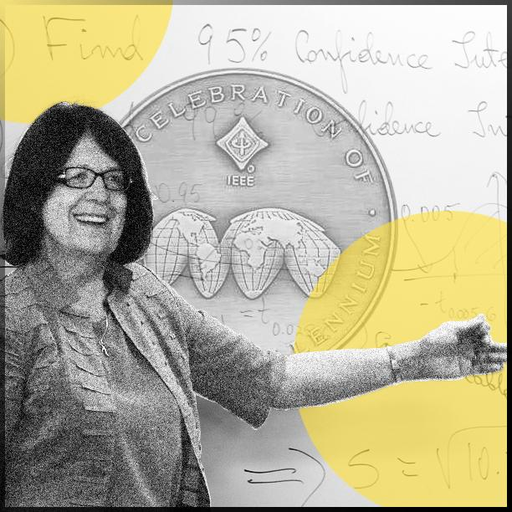

Bozenna
Pasic-Duncan
(b.1947)
If you choose only one course at the university, choose mathematical statistics because we deal now with data, randomness, and uncertainty.

Slide 14
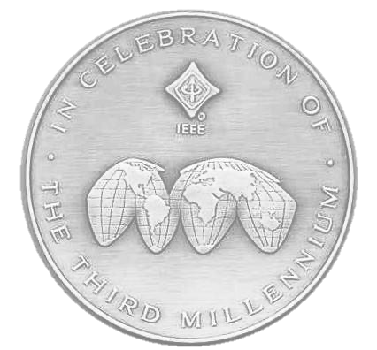
Polish mathematician, expert in stochastic control and a champion for women in engineering
Best known for:
  Her passionate approach to mathematical education and promoting women in STEM (i.e. Science, Technology, Engineering, and Maths). She co-founded the Women in Control group within the Institute of Electrical and Electronics Engineers (IEEE) Control Systems Society and has chaired the Women in Engineering group of 20 000 global members. Bozenna Pasik-Duncan has also been chair of the International Federation of Automatic Control (IFAC) task force on diversity and inclusion.
    Education:
      Mathematics at the university of Warsaw.

Slide 15

Research advances
Applying the theory of stochastic adaptive control in various fields such as aerospace guidance and control, signal processing and communications, manufacturing processes, financial economics, and health science.
Honors and awards:
Bozenna Pasik-Duncan has received numerous awards for her efforts as a teacher and for supporting and promoting women in STEM fields. She has also received the IEEE Control Systems Society Distinguished Member Award and the IFAC Outstanding Service Award for her many years of service to IEEE and IFAC in senior positions.

Slide 16
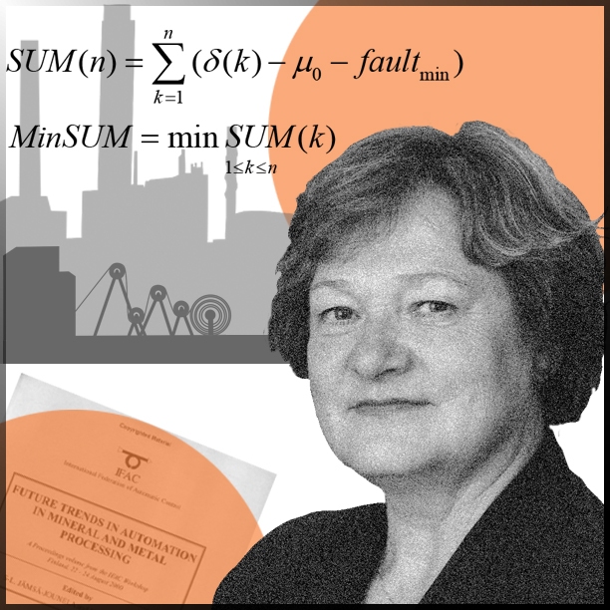

Sirkka-Liisa
Jämsä-Jounela
(b.1952)
If you are interested in and love your work, you will be successful.

Slide 17

Finnish engineer and specialist in advanced control strategies and fault monitoring
Best known for:
Her comprehensive work in developing new and efficient process control and management theories, increasing the sustainability of production processes in the process industry.
Appointments:
Professor at Aalto University, vice chair and chair of IFAC’s Technical Board, and vice president of IFAC*.
*International Federation of Automatic Control

Slide 18

Honors and awards:
The IFAC Distinguished Service Award for IFAC officials who have served and contributed substantially to IFAC and the Order of the White Rose of Finland, conferred upon citizens who have distinguished themselves in the service of Finland.
Education:
Mathematics, technical physics, process engineering, and control at Oulu University.
Influences:
Her colleagues in IFAC. As a prominent figure in IFAC, Sirkka-Liisa Jämsä-Jounela herself has positively encouraged many young women engineers to proceed within the field of engineering.

Slide 19
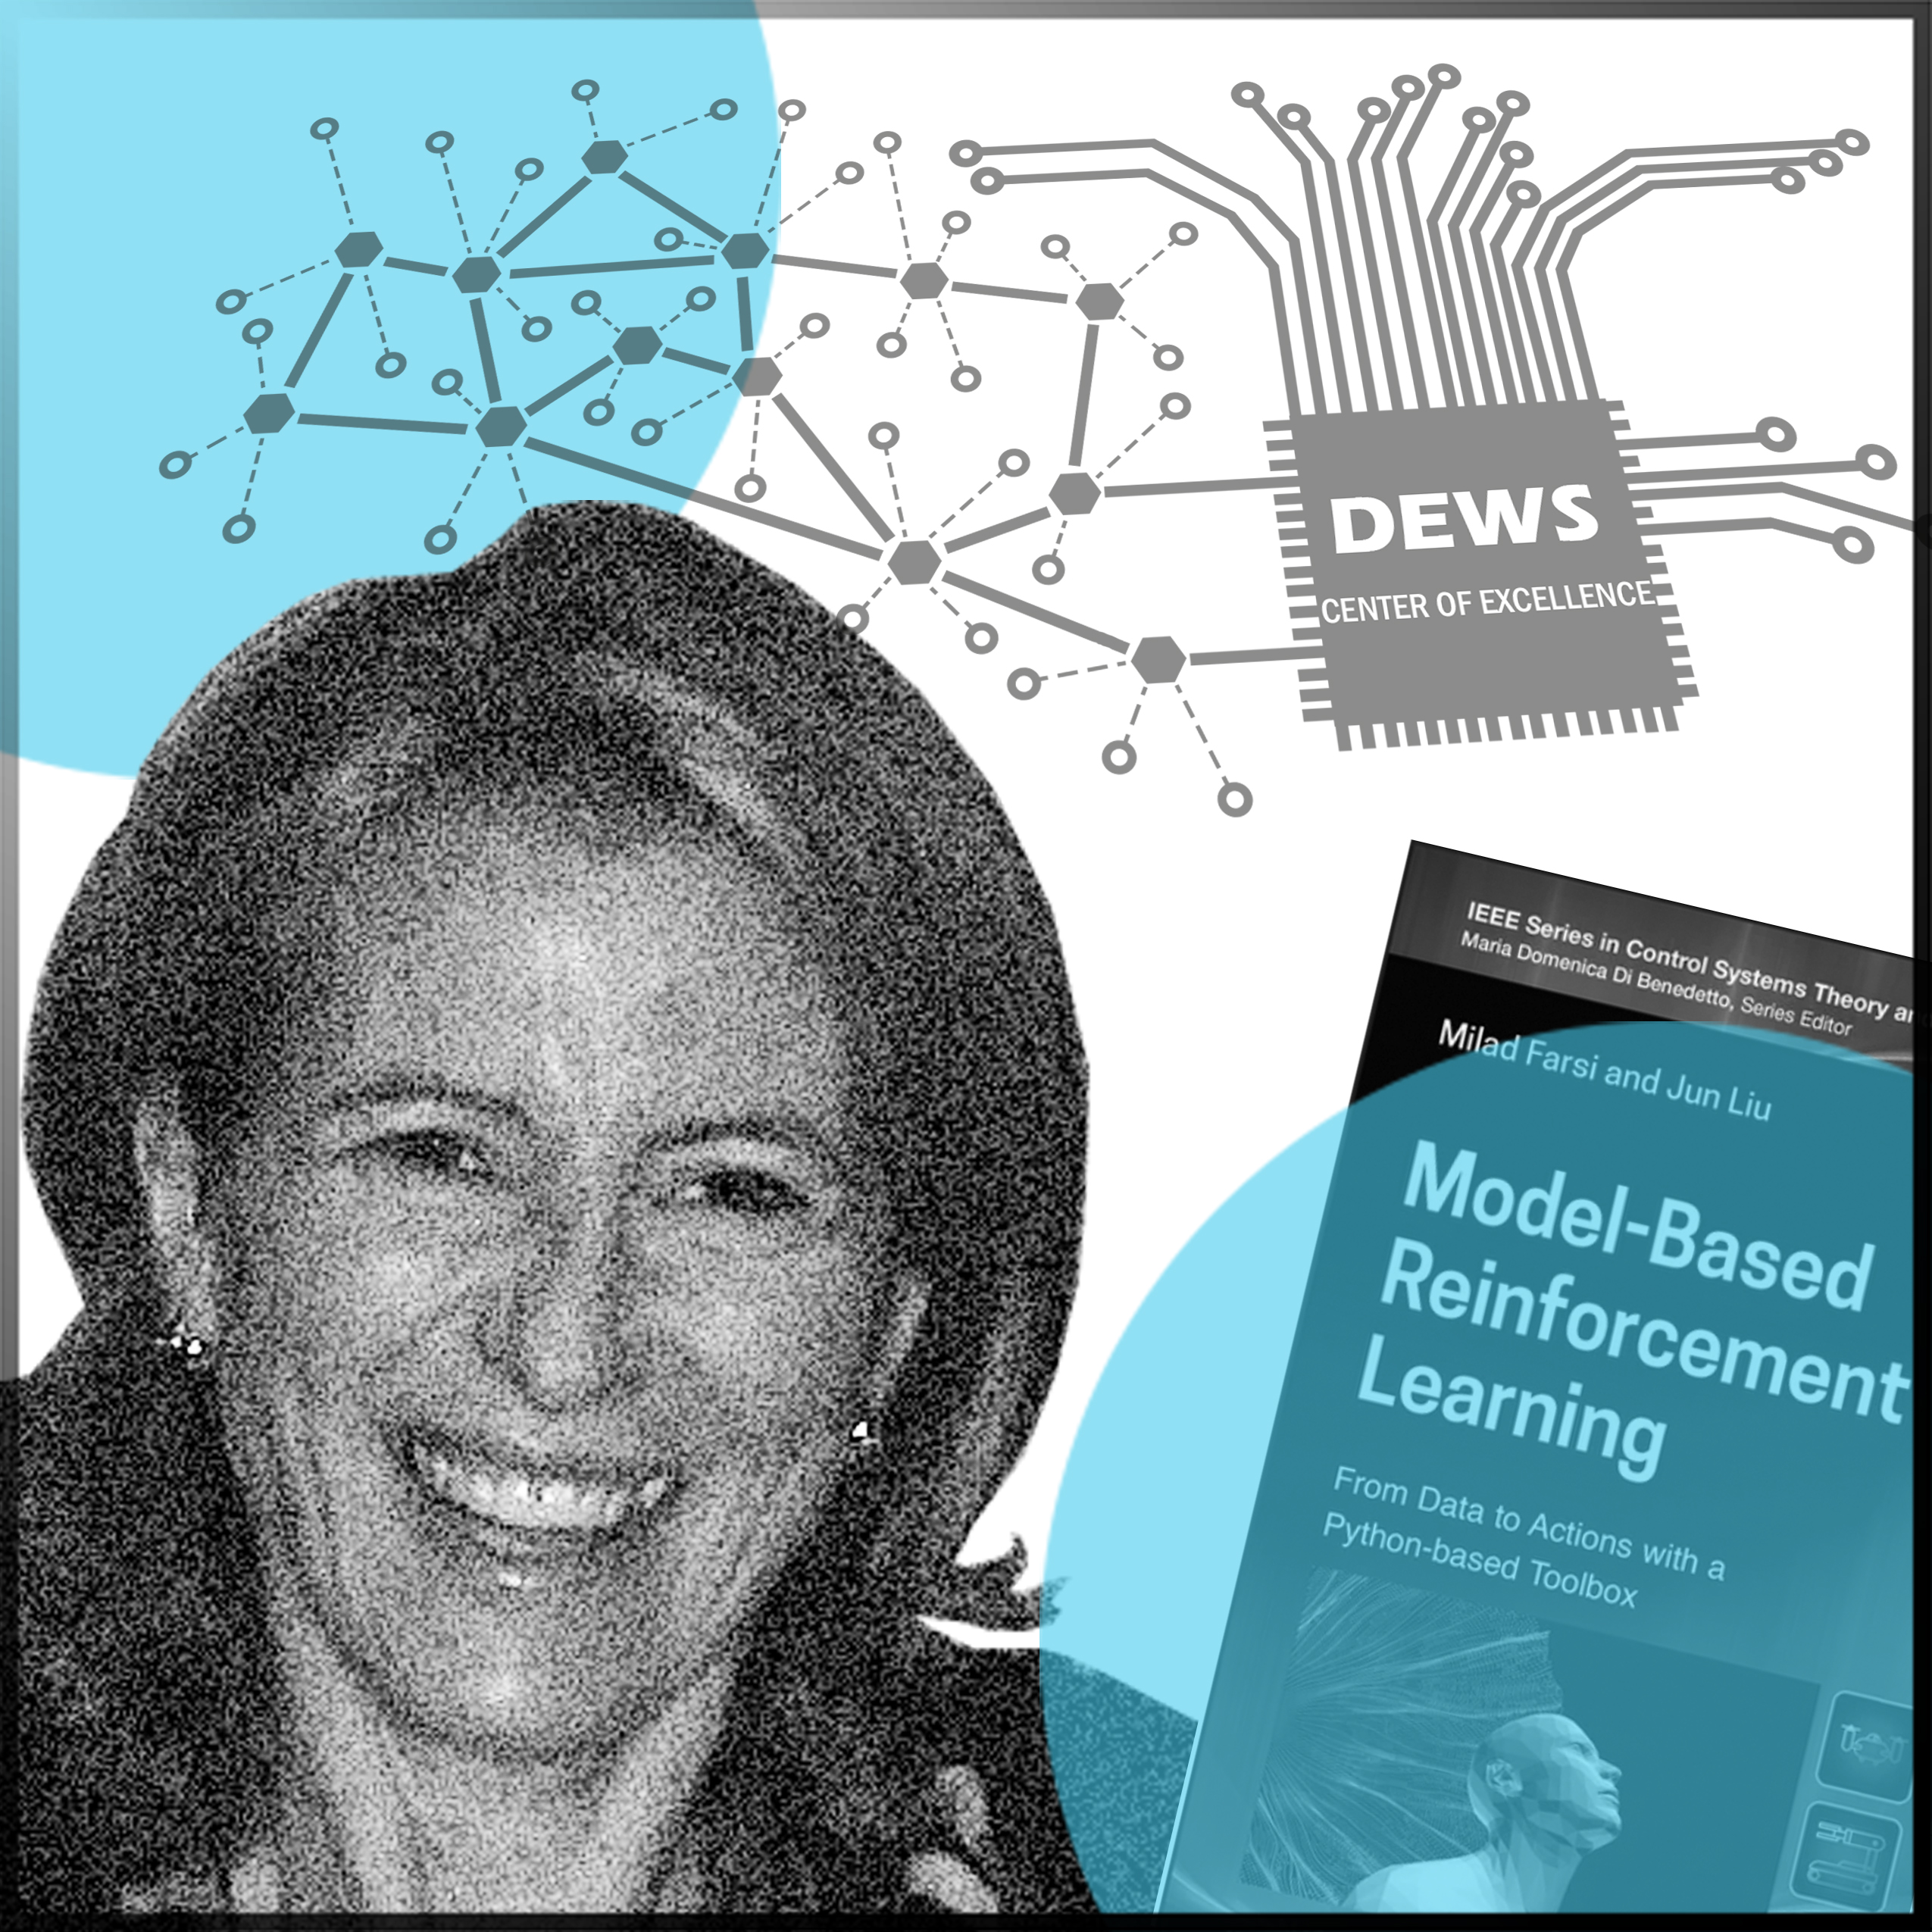

Maria Domenica
Di Benedetto
(b.1953)
You have to believe that you can do it. You have to practice and make the effort, and it is hard. But never give up!

Slide 20
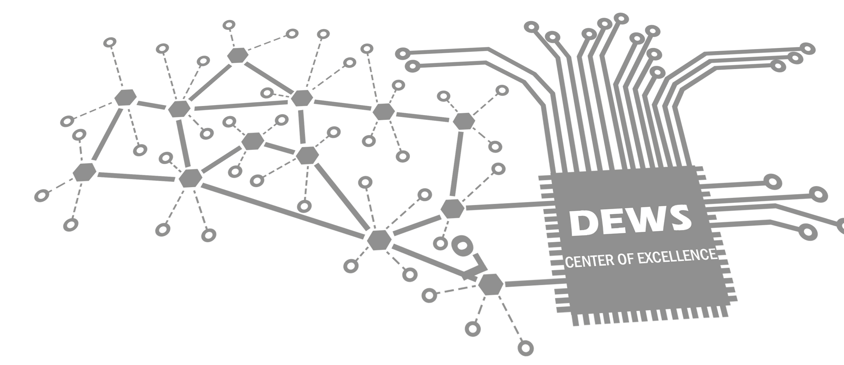
Italian professor specialised in the science of nonlinear and hybrid systems and their applications
Best known for:
Her multidisciplinary approach to research and strong interest in the application and implementation of control in various fields, ranging from automotive and air traffic control to control within the environmental, biological, and medical fields.
Appointments:
Professor at the University of L’Aquila and founder and director of the Center of Excellence DEWS.

Slide 21

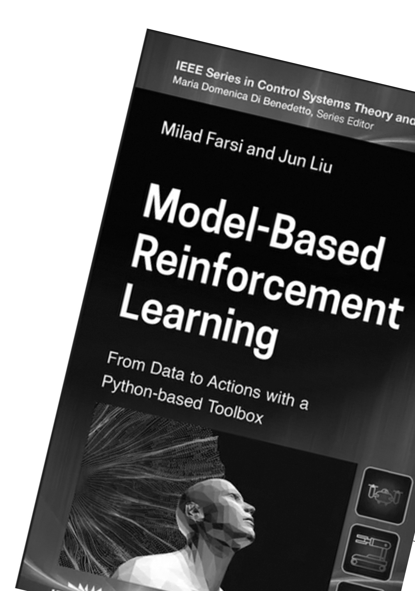
International influence:
Maria Domenica Di Benedetto has held several positions as a visiting scientist and guest professor, among other places, at the University of Berkeley, the University of Michigan, Centre National de la Recherche Scientifique (CNRS) in Nantes, and the MIT School of Engineering. She has also been the editor of several prestigious international scientific magazines.
Education:
Bachelor’s degree in electrical engineering at the Sapienza University of Rome and a PhD in control systems at the University of Paris.
Influences:
Her father, who was a mathematician, and two excellent teachers in systems theory and automatic control, in Antonio Roberti and Alberto Isidori.

Slide 22
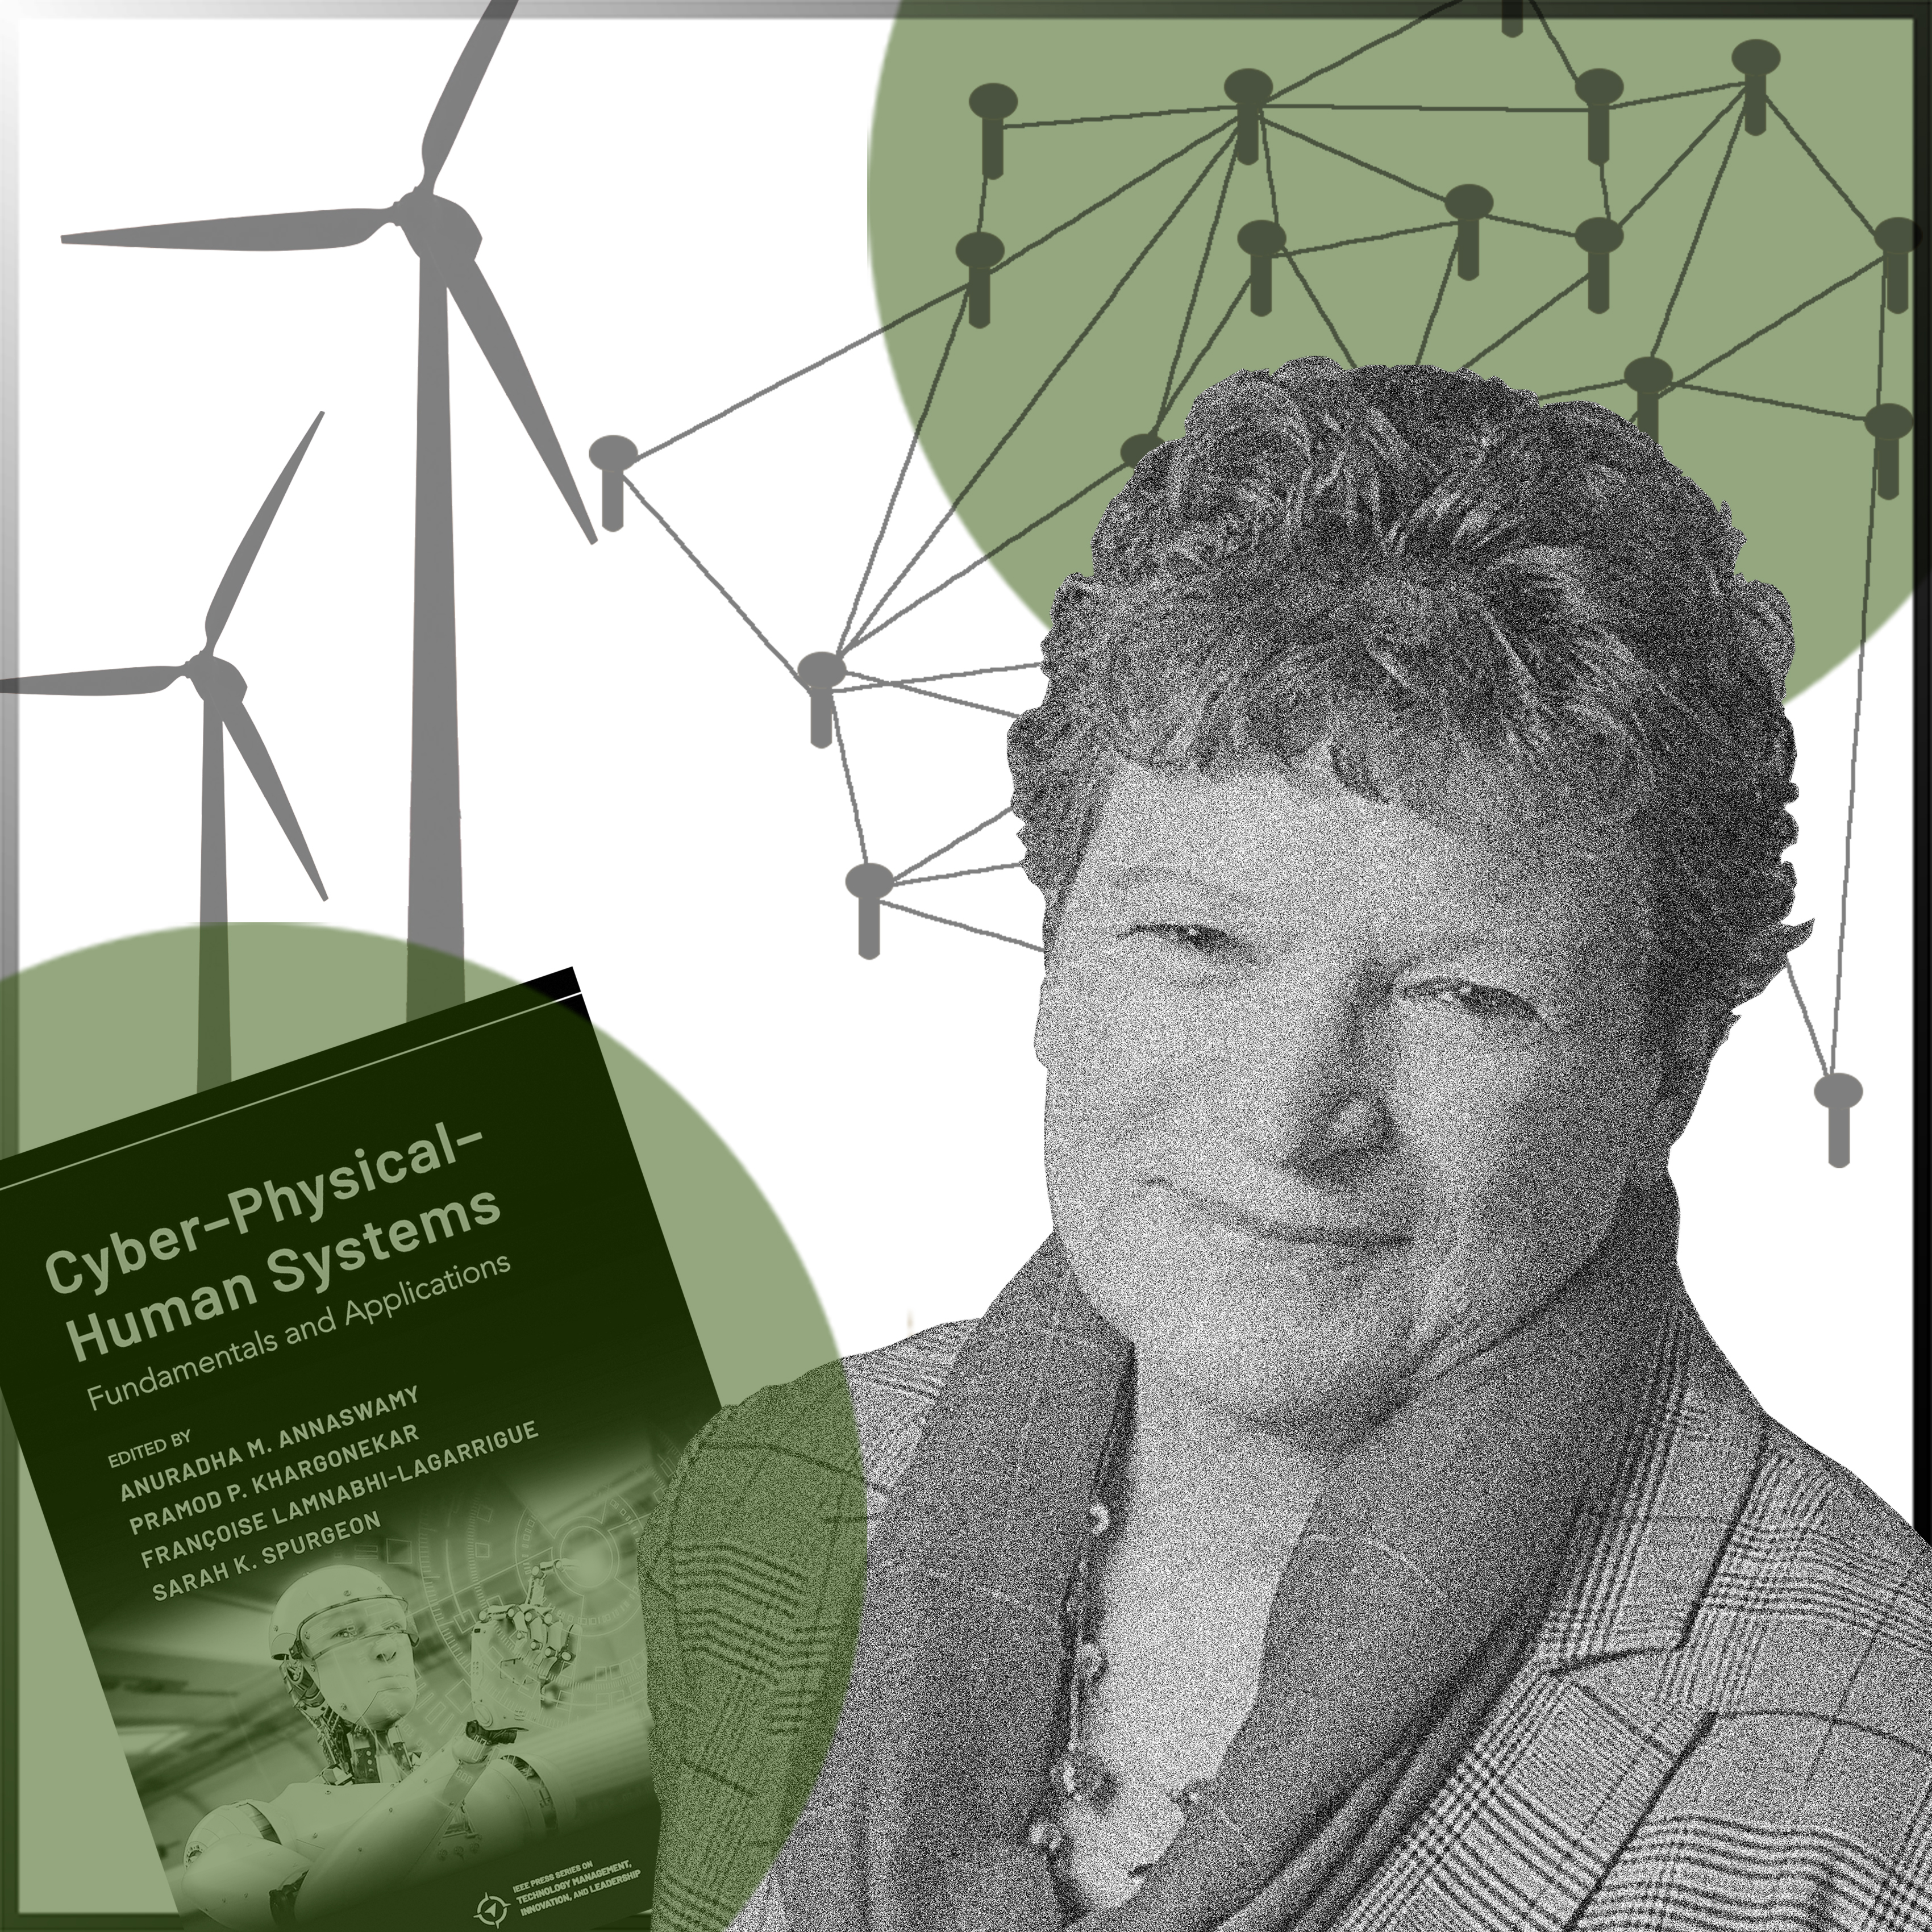

Françoise
Lamnabhi-Lagarrigue
(b.1953)
Success is often the consequence of taking risks, encouraged or not, in new directions or with new tools.

Slide 23

French control theorist and expert in uncertain nonlinear systems and hybrid systems
Best known for:
Her theoretical advances in analyzing and controlling complex nonlinear systems and their application in power and neural networks. She has been the editor of several prestigious international scientific magazines within control and is the author of several books.
Appointments:
Professor at the French National Centre for Scientific Research (CNRS).

Slide 24


International influence:
Françoise Lamnabhi-Lagarrigue has been a pioneer in building relationships between European research groups within nonlinear control. She has created and supervised several large research networks and founded the European Embedded Control Institute.
Honors and awards:
She has received the Michel Monpetit Prize and the Iréne Joliot-Curie Prize as Woman Scientist of the Year for her research in automation.
Education:
A master’s degree in mathematics at the University of Paul Sabatier in Tolouse and a PhD in signal processing and control theory at the University of Paris-Saclay.

Slide 25
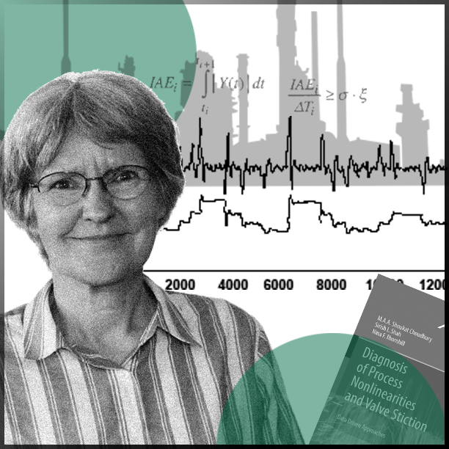
Nina F.
Thornhill
(b.1953)
You can find anything you want in data, but whether it is meaningful requires one to understand the processes behind the analysed systems.

Slide 26
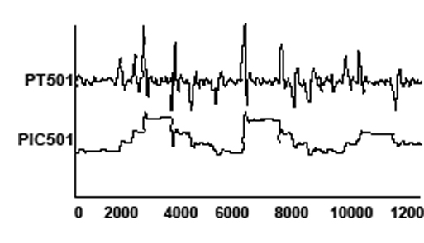
British innovator of tools and approaches for a more sustainable operation of large-scale production plants
Best known for:
Her innovative approaches and tools for process monitoring, and for the detection and diagnosis of persistent faults in the operation of large-scale industrial systems, such as chemical plants.
Appointments:
Professor at the Department of Electronic and Electrical Engineering at the University College of London and ABB/Royal Academy of Engineering Chair of Process Automation at the Department of Chemical Engineering, Imperial College London.

Slide 27

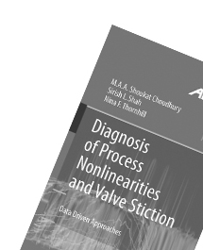
Honors and awards:
The Nordic Process Control Award for her research contributions and significant contributions as a coordinator of several European Marie Sklodowska-Curie projects, bringing together industrial and academic partners to train early-stage researchers in the field of process automation and control.
Education:
Bachelor’s degree in physics from Oxford University and master’s degree in control systems at Imperial College London.
Influences:
Her father, who was a physicist.

