Slide 1
Tomorrow's Robotics Today

Slide 2
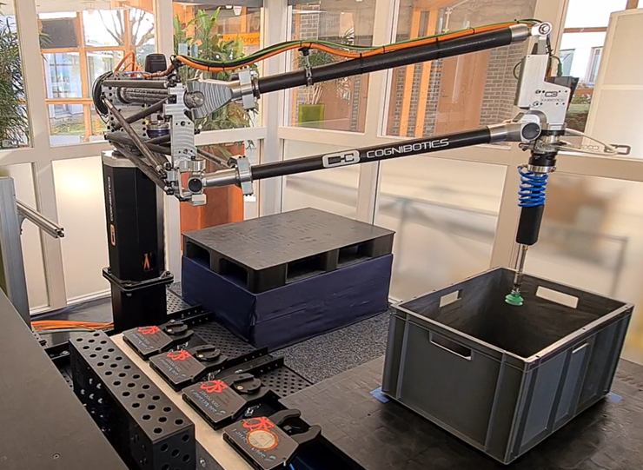
LTH startup from 2013
~40 employees
Find us in the M-house robot lab
Motion control, calibration, robot language
Making robots better!

Slide 3
Making robots more productive
Enhanced robot
+ Higher accuracy enables more applications and quality output
+ High speed and long reach increase productivity and extend application space
+ Easier programming, haptic or offline, creates ease-of-use
Accuracy & Stiffness
Today’s robot
Challenges:
- High initial cost of robots
- Lack of programmers
- Difficult programming
- Low speed & accuracy
Speed & Reach
Ease-of-use
Notes:
Problem: Limited growth
Robot automation is limited
Productivity per sqm is lower with robots than humans
This gives estimated business opportunity (sizeable)
SMB; 8 out of 10 would like to have higher automation but….

Slide 4
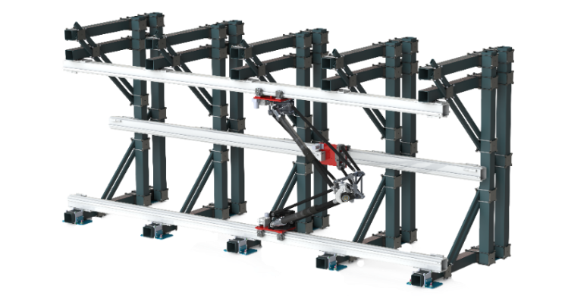
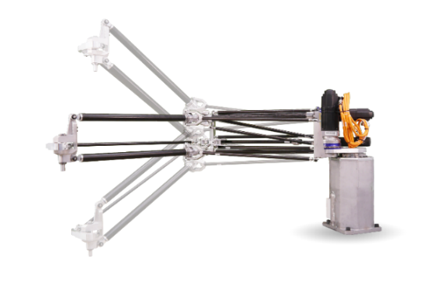
A new class of performance robotics
Motion Precision
SigmaTau
HKM 1800
Increase Productivity by Accuracy, control software for robot- calibration and motion compensation
Lightweight robot system for high-speed machining and welding of large workpieces
Long-reach pick-and-place robot for warehousing, logistics and machine tending
Accuracy
Ease-of-Use
Reach
Stiffness
Accuracy
Reach
Speed
Systems Products
Software-defined robot, next generation of real time motion control, programming, and robot performance.
Common scalable motion platforms
Ease-of-Use
Notes:
DENNA BILDEN ÄR FÖR KRÅNGLIG.

Slide 5
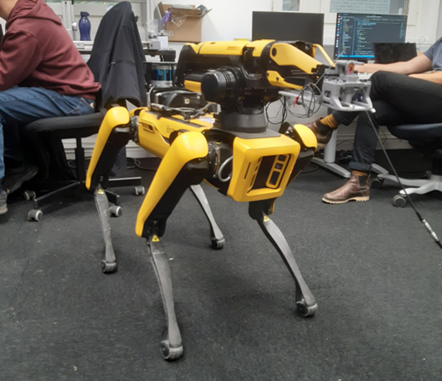
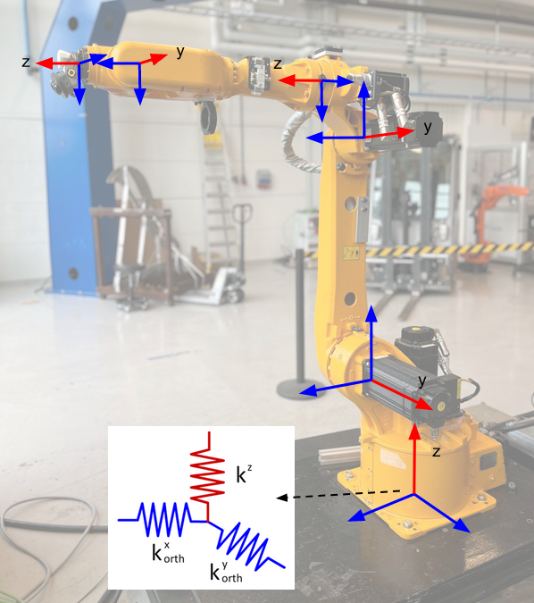
Master thesis
Past thesis subjects
Building dense reconstructions with SLAM and Spot
Automation of marking tasks at MAX IV using Spot
Anomaly detection for HKM robot using Machine Learning
Tool design for HKM robot
Component design for SigmaTau robot
Input shaping as a vibration damping method
Optimization of object placement using constraint programming
Notes:
Problem: Limited growth
Robot automation is limited
Productivity per sqm is lower with robots than humans
This gives estimated business opportunity (sizeable)
SMB; 8 out of 10 would like to have higher automation but….

Slide 6
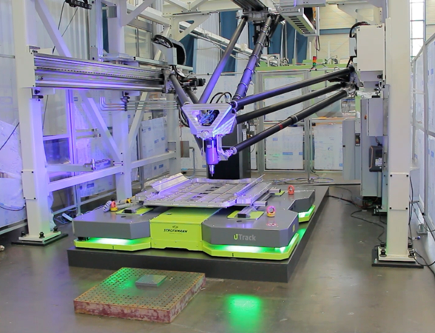
Master thesis
Potential subjects
Force control for SigmaTau robot
Nodding compensation for SigmaTau robot
Vacuum tool development for HKM robot
Improvement of strategies for picking and placing for HKM robot
Improvement of certain movements of HKM robot
Your interests!
Interested in master thesis, summer work or full-time work?
Contact us!
philip.olhager@cognibotics.com
klas@cognibotics.com
Notes:
Problem: Limited growth
Robot automation is limited
Productivity per sqm is lower with robots than humans
This gives estimated business opportunity (sizeable)
SMB; 8 out of 10 would like to have higher automation but….

Slide 7
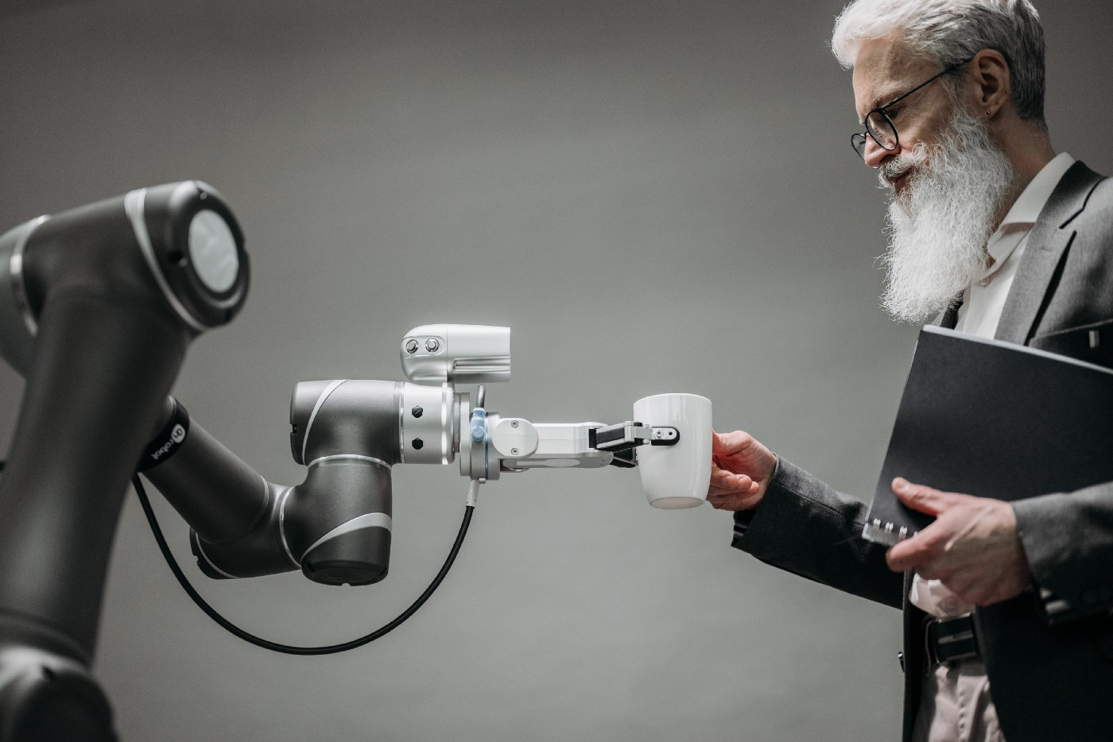
Thank You!

